Slide 1
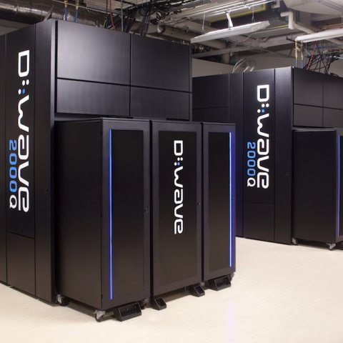
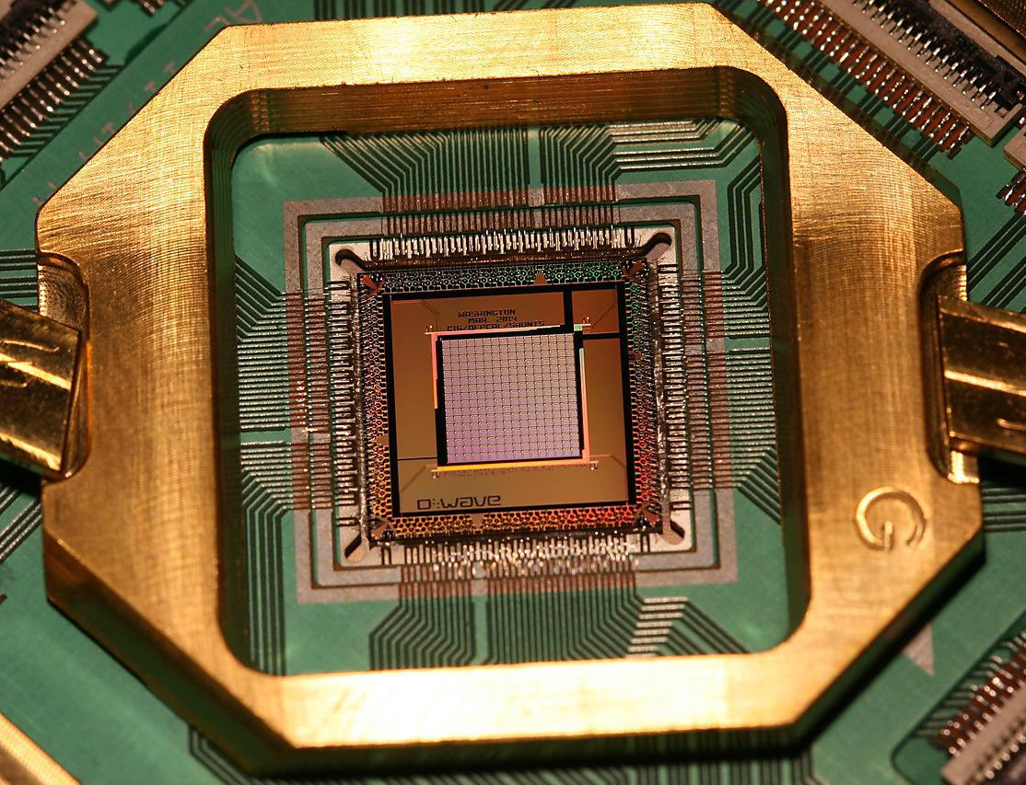
SudoQ A Quantum solver for Sudoku
Ayush Yembarwar

Slide 2
Outline
Qubits
Why Quantum
Quantum Technologies - Near Term
Problems
Solution
Results and Analysis
Next Steps
Questions

Slide 3
Quantum Computing (1959 - )

Slide 4
Why Quantum?
Because quantum solutions perform better at certain tasks
Quantum Superposition
Quantum Entanglement
Qubits scale exponentially (2^{n})
Quantum algorithms
Moore's Law failing, Neven's law succeeding
Success of Rose's Law
Quantum solutions scale much more easily
Amount of data is increasing exponentially, classical algorithms cannot keep up

Slide 5
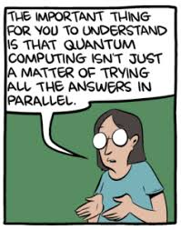
SMBC Break
Although SMBC tells us not to do exactly this, this is exactly what we're gonna do, we're gonna assume that the quantum computer is working through all the possibilities simultaneously.

Slide 6
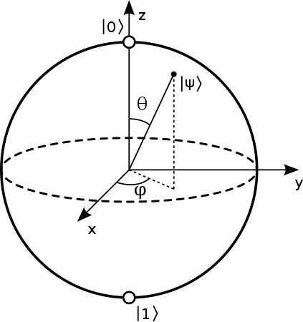
Qubits
Classical bits are either 0 or 1, quantum bits have been described as being 0 and 1
A more mathematical definition would be that the condition of n qubits is like a vector in a 2^{n} dimensional Hilbert space

Slide 7
What we can’t do near-term
Quantum computing technologies just aren't there yet
Shor’s algorithm (of order 10⁸ qubits c.f. Fowler et al. 1208.0928)
Anything with a quantum RAM
Fault-tolerant quantum computation
Advanced Quantum Algorithms
Algorithms requiring large number of Qubits
Notes:
Just some rain on all our parades

Slide 8
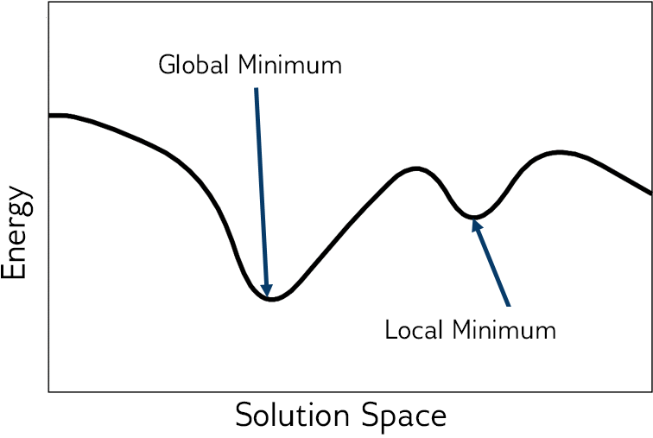
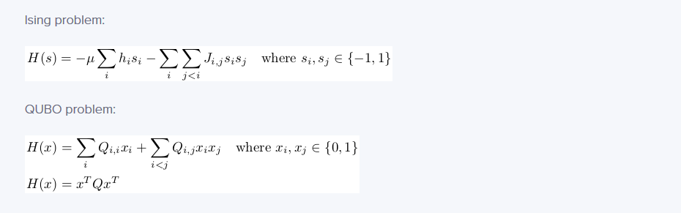
BQM Problem
BQM stands for Binary Quadratic Model. H(x,y) = x + 4y -32xy
Ising:
QUBO:
Notes:
Convex - ML rant

Slide 9
QUBO versus Ising (01)
Essentially, not very different
Ising uses spin variables (+1, -1) whereas QUBO uses binary variables (1, 0)
They are isomorphic
Ising can only be expressed in extended form, not in matrix form
QUBO can be expressed in matrix as well as expanded forms
Notes:
I might use them interchangeably since they are isomorphic

Slide 10
QUBO versus Ising (02)
ISING equation for equals operation
QUBO equation for equals operation
x | y | x==y | xy
1 | 1 | TRUE | 1
1 | -1 | FALSE | -1
-1 | 1 | FALSE | -1
-1 | -1 | TRUE | 1
x | y | x==y | 2xy-x-y
1 | 1 | TRUE | 1
1 | 0 | FALSE | 0
0 | 1 | FALSE | 0
0 | 0 | TRUE | 1
Notes:
some concepts are more easily expressed in Ising than in QUBO, and vice versa, that's why some solutions might be apparent while using Ising but might be exceptionally difiicult to arrive at while using QUBO

Slide 11

QUBO versus Ising (03)
Since the D'Wave backend works with Ising, formulating the problem in Ising is useful. The linear weights have a range of [-2,2] and the quadratic weight are limited by [1,1] Converting a problem from QUBO to Ising might turn up coefficients with a large range which might get ignored. For example:
This causes problems. Always safe to try to model problems in Ising variables. This might take getting used to
Notes:
Always be sure to pay attention to these ranges for weightages.
Always safe to try to model problems in Ising variables. This might take getting used to.

Slide 12
Coverting constraints to Loss function
We wish to convert the constraint of x=y into a loss function which when minimized would fulfill the constraint. Let the loss function denoted by H be, H = (x-y)^2
Thus, when the loss function is minimized, the constraint is also satisfied. Other constraints can be modelled using other loss functions Our final H is a summation of all such 'H's
x | y | x==y | H
1 | 1 | TRUE | 0
1 | 0 | FALSE | 1
0 | 1 | FALSE | 1
0 | 0 | TRUE | 0

Slide 13
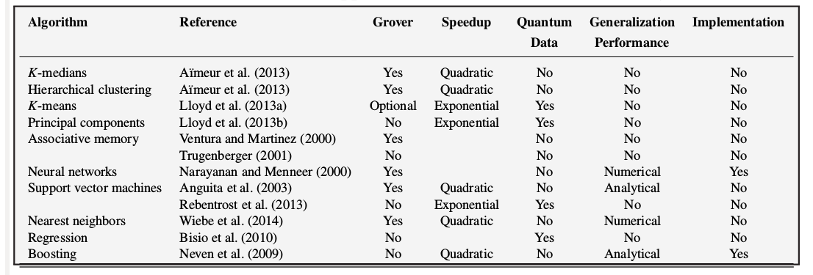
Problems we can solve right now
Despite these obstacles, we found some graph/network problems that can be solved with quantum computers efficiently
Quadratic Unconstrained Binary Optimization (QUBO) Problems
21 types of NP Complete graph problems like Max-Cut, Min-Cut, Max Clique finding, graph coloring

Slide 14
Chosen Problem: Sudoku

Slide 15
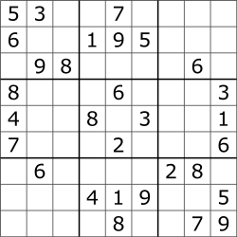
The problem - Sudoku
It's a combinatorial, number placing puzzle
The objective is to place numbers from 1 through 9, exactly once in each column, row and 3x3 subgrid
Gets easier as the number of digits already filled increases
Notes:
Everyone here knows Sudkou right? If not I can explain the rules quickly.
Since it is combinatorial, the size of the possible solution space increases rapidly with an increase in the size of the problem.

Slide 16
Assumptions
We have assumed that each puzzle has exactly one solution This way we can use voting for our final answer

Slide 17
Modelling Sudoku

Slide 18
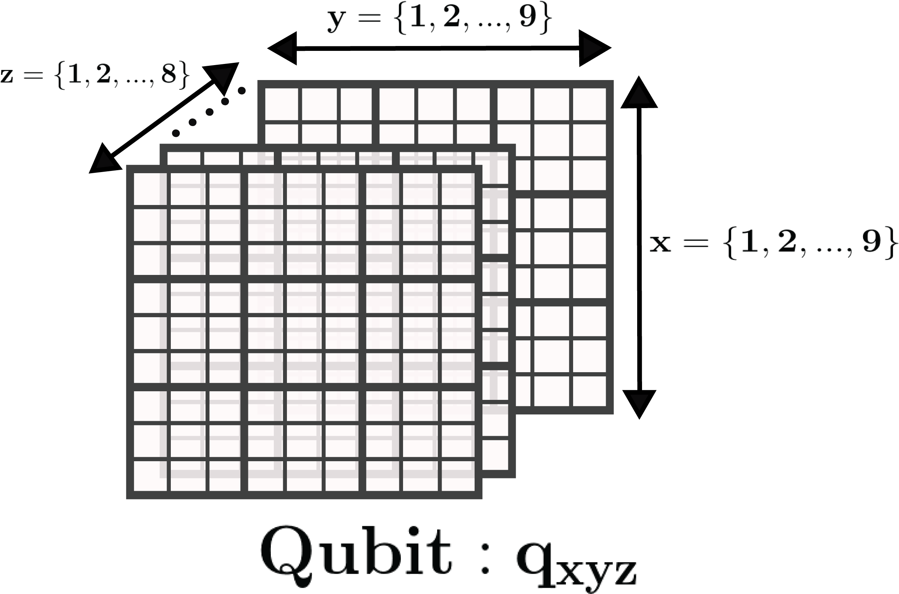
Qubit modelling
Each square has one digit from 1 through 9. We model those 9 numbers with 8 qubits. (call it an 8-group) This can be called 'one-hot and zero' encoding
That makes 648 such qubits
Notes:
zero_onehot

Slide 19
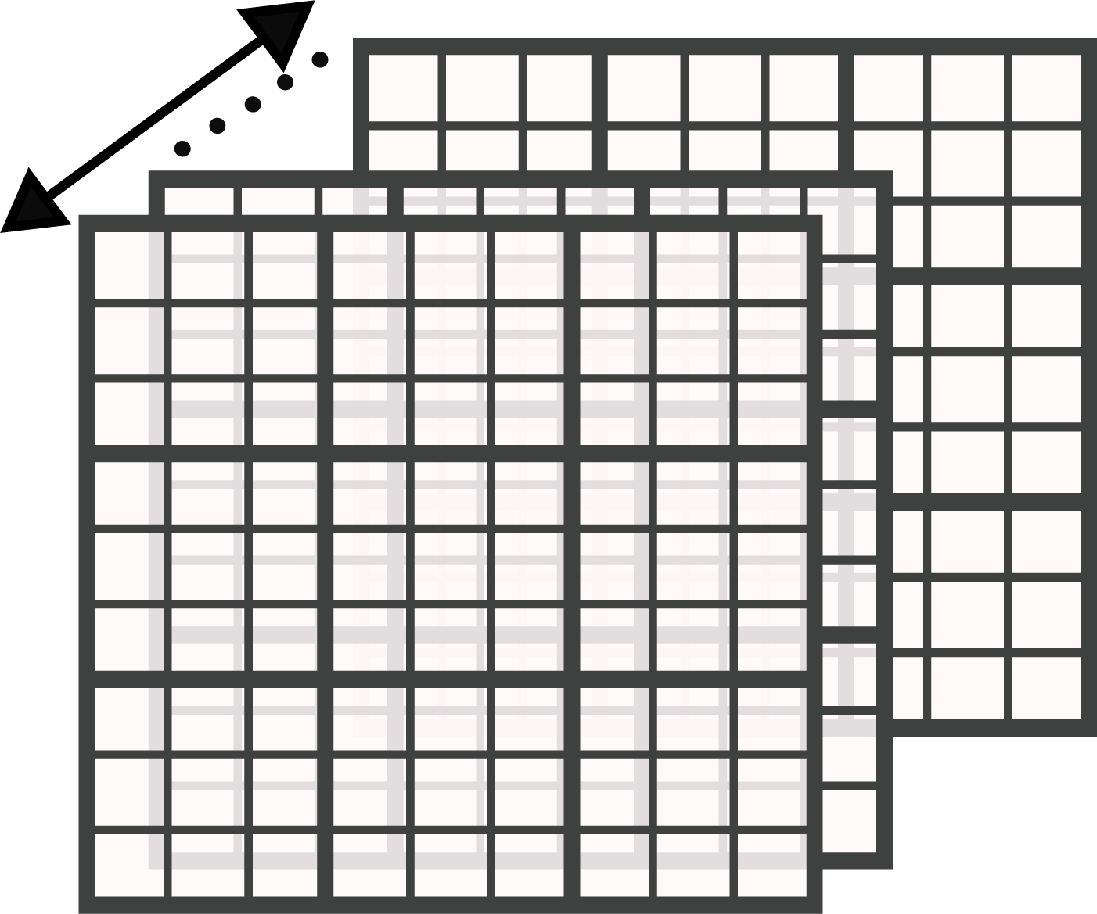
Constraints
1. Each 8-group should have at most one qubit in the '1' state, all the others in '0' state 2. Each row has all 9 digits appearing only once 3. Each column has all 9 digits appearing only once 4. Each 3x3 subgrid has all 9 digits appearing only once
Notes:
Everyone here knows Sudkou right? If not I can explain the rules quickly.
Since it is combinatorial, the size of the possible solution space increases rapidly with an increase in the size of the problem.

Slide 20
Solution Proposal

Slide 21
Solution Presented
01
Here is a step-by-step outline of the solution:
1) Formulate problem into mathematical structures
2) Identify the problem constraints
3) Model the loss function taking everything into account
4) Determine solutions for the loss function
5) Determmine a vote based final solution
6) Validate and analyze the final answer that you arrived at
High level Algorithm for our solution

Slide 22
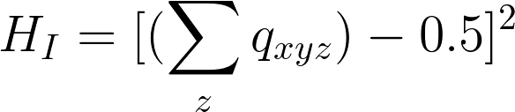
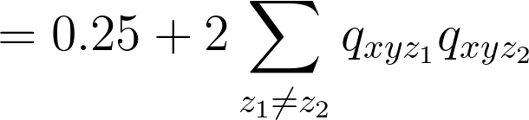
Solution Presented
02
Each 8-group should have at most one qubit in the '1' state
Therefore, allowed sum of this 8-group qubits should be 1 or 0
The disallowed summation values are: 2, 3, 4, 5, 6, 7, 8
Allowed values ensure a minima of the following loss function
On expansion, this equation becomes
1
Constraint 1

Slide 23
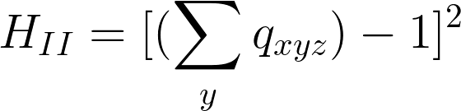
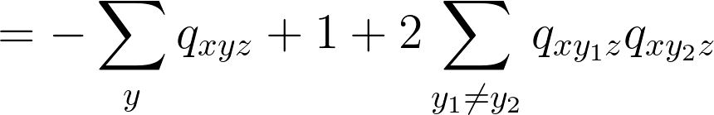
Solution Presented
03
Each number appears once in a row
Consider a fixed z and x, going over the values of y the sum should be 1
The loss function look like so
On expansion, this equation becomes
1
Constraint 2

Slide 24
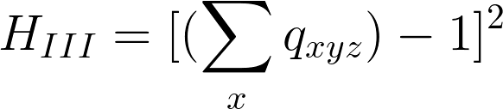

Solution Presented
04
Each number appears once in a column
Consider a fixed z and y, going over the values of x the sum should be 1
The loss function look like so
On expansion, this equation becomes
1
Constraint 3

Slide 25
Solution Presented
05
Each number appears once in a 3x3 subgrid
Consider a fixed z , going over the values of x and y in a subgrid, the sum should be 1
We can construct a similar Loss function to the ones we've made so far
1
Constraint 4

Slide 26
Solution Presented
06
Summate over the individual loss functions
We have no other objective function to optimize. We've converted our constraints into individual loss function elements.
The final loss function is given by-
1
Final Loss function

Slide 27
Code
Language used: Python 3.5
Libraries used: NumPy
D'Wave qbsolv
D'Wave SAPI
OSMnx
NetworkX
Seaborn

Slide 28
Analysis of the Quantum solution

Slide 29
Analysis
The solution is modeled to work on a specific type of quantum computers called Quantum Annealers. Examples include D-Wave's quantum computers.
Since we did not have access to a quantum computer we had to use qbsolv, a simulator for D-Wave's quantum computers that works on normal classical computers.
Can solve simple Sudoku puzzles
Notes:
D'Wave is the only company making these rn
I did try it on the quantum computer, but I missed my second of use
The difficult ones are, ... well .... difficult, the errors in measurements are far too great

Slide 30
Original Puzzle
1 | 4 |  | 7 | 9 | 2 |  | 8 | 5
2 |  | 8 | 3 | 4 | 6 | 7 | 9 | 1
3 | 7 | 9 |  |  | 1 | 4 |  | 2
4 | 3 | 7 | 9 | 1 | 5 | 8 | 2
5 |  | 1 | 6 |  | 7 | 9 | 3 | 4
6 | 9 | 2 | 4 | 3 | 8 | 1 | 5 | 7
7 |  |  | 2 | 6 | 9 |  | 4 | 8
8 | 2 | 4 | 1 | 5 | 3 | 6 | 7 | 9
9 |  | 5 | 8 | 7 |  | 2 | 1 | 3

Slide 31
Solved Puzzle
1 | 4 | 6 | 7 | 9 | 2 | 3 | 8 | 5
2 | 5 | 8 | 3 | 4 | 6 | 7 | 9 | 1
3 | 7 | 9 | 5 | 8 | 1 | 4 | 6 | 2
4 | 3 | 7 | 9 | 1 | 5 | 8 | 2 | 6
5 | 8 | 1 | 6 | 2 | 7 | 9 | 3 | 4
6 | 9 | 2 | 4 | 3 | 8 | 1 | 5 | 7
7 | 1 | 3 | 2 | 6 | 9 | 5 | 4 | 8
8 | 2 | 4 | 1 | 5 | 3 | 6 | 7 | 9
9 | 6 | 5 | 8 | 7 | 4 | 2 | 1 | 3

Slide 32
Next Steps

Slide 33
Stuff not addressed
QUBO graph embedding
Chimera structure
Fully Connected graphs
D'wave Ocean Kit Functionality
Digital Annealers
Graph Problems that can solved by D'Wave
How simulated annealing works
How quantum annealing works

Slide 34
SudoQ: Problem flow
Future
Identifying Constraints
Modelling Constraints
QUBO Formulation
Make Python code efficient
Develop heuristics for the relative coefficients between each mini loss function

Slide 35
Questions?

Slide 36
Contact Details mail: ayushyembarwar@gmail.com f2016657@pilani.bits-pilani.ac.in

Slide 37
Links - subwayharearmy.github.io/2019/03/23/sudoq-quantum-sudoku-solver - https://github.com/subwayHareArmy/SudoQ

Slide 38
Thank You
Notes:
yeh kya padh raha gandu, thank you bola tha

